Slide 1
Hibernate

Slide 2
History
Developer-Galvin King
Year -2001
Hibernate means Sleep Mode

Slide 3
Feature of Hibernate
1.Auto DDL-
2.HQL(Data base Independent)
3.Cache Support- first level(session Level), second factory level-
4.PK Generation
5.Validation
6.Exception Free
Select id, name from employee;--SQL
Select id, name from employee-- HQL

Slide 4
Feature of Hibernate
7.ORM Support(IS A and HAS A Relation for SQL)
8.OGM(Object Graph Mapping for Non SQL)

Slide 5
Component Required
1.POJO Class
2.Mapping File(it is a xml File)
3.Configraion File(It is XML File)
4.Test Class

Slide 6
POJO Class
public class Student {
private String id;
private String name;
private String email;
With Constructor ,Setter,Getter

Slide 7
Mapping File
<!DOCTYPE hibernate-mapping PUBLIC
"-//Hibernate/Hibernate Mapping DTD 3.0//EN"
"http://hibernate.sourceforge.net/hibernate-mapping-3.0.dtd">
<hibernate-mapping>
<class name="beans.Student" table="employee007" schema="system">
<id name = "id" type = "int" column = "id"/>
<property name = "firstName" column = "first_name" type = "string“ length=“30”>
<property name="email"/>
</class>
</hibernate-mapping>

Slide 8
Configuration File
<?xml version="1.0" encoding="utf-8"?>
<!DOCTYPE hibernate-configuration PUBLIC
"-//Hibernate/Hibernate Configuration DTD//EN"
"http://hibernate.sourceforge.net/hibernate-configuration-3.0.dtd">
<hibernate-configuration>
<session-factory>
<property name="connection.driver_class">oracle.jdbc.OracleDriver</property>
<property name="connection.url">jdbc:oracle:thin:@irfan-PC:1038:xe</property>
<property name="connection.username">system</property>
<property name="connection.password">khan</property>
<property name="connection.pool_size">10</property>
<property name="dialect">org.hibernate.dialect.OracleDialect</property>
<property name="hbm2ddl.auto">create or update or Validate or Create-drop</property>
<property name="show_sql">true</property>
<property name="format_sql">true</property>
<mapping resource="resources/student.hbm.xml"/>
</session-factory>
</hibernate-configuration>

Slide 9
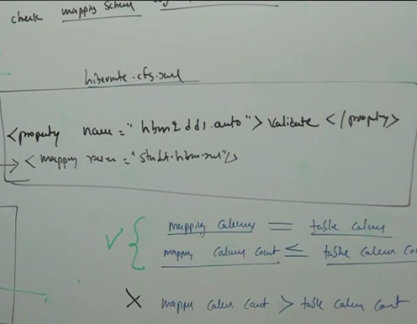
<property name="hbm2ddl.auto">Validate</property>

Slide 10
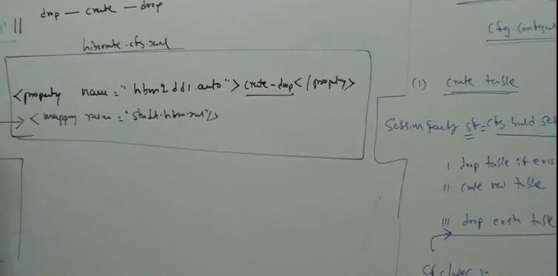
<property name="hbm2ddl.auto">create-drop</property>

Slide 11
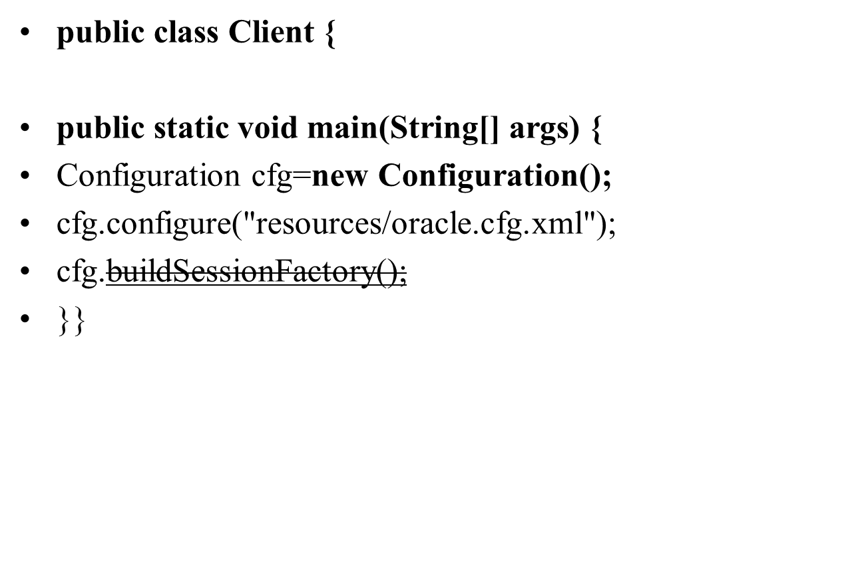
Test Class

Slide 12
Criteria
Criteria is a simplified API for retrieving entities by composing Criterion objects. This is a very convenient approach for functionality like "search" screens where there is a variable number of conditions to be placed upon the result set.
Step for Creating Object of Criteria
Criteria cr = session.createCriteria(Employee.class);
List results = cr.list();

Slide 13
Method of Criteria
1.list()
2.UniqueObject

Slide 14
Restrictions with Criteria
You can use add() method available for Criteria object to add restriction for a criteria query. Following is the example to add a restriction to return the records with salary is equal to 2000
Criteria cr = session.createCriteria(Employee.class); cr.add(Restrictions.eq("salary", 2000));
List results = cr.list();

Slide 15
Method of Restriction
Criteria cr = session.createCriteria(Employee.class);
// To get records having salary more than 2000
cr.add(Restrictions.gt("salary", 2000));
// To get records having salary less than 2000 cr.add(Restrictions.lt("salary", 2000));
// To get records having fistName starting with zara cr.add(Restrictions.like("firstName", "zara%"));
// Case sensitive form of the above restriction. cr.add(Restrictions.ilike("firstName", "zara%"));

Slide 16
Method of Restriction
// To get records having salary in between 1000 and 2000 cr.add(Restrictions.between("salary", 1000, 2000));
// To check if the given property is null cr.add(Restrictions.isNull("salary"));
// To check if the given property is not null cr.add(Restrictions.isNotNull("salary"));
// To check if the given property is empty cr.add(Restrictions.isEmpty("salary"));
// To check if the given property is not empty cr.add(Restrictions.isNotEmpty("salary"));

Slide 17
Criteria with Projection
Projection is used for fetching single column record as well as aggregate function like name only, max salary,min,count,avg etc.

Slide 18
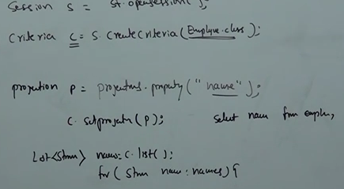
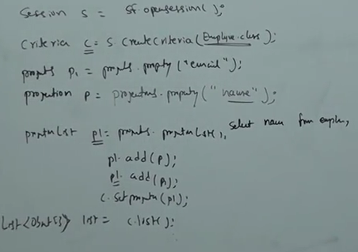
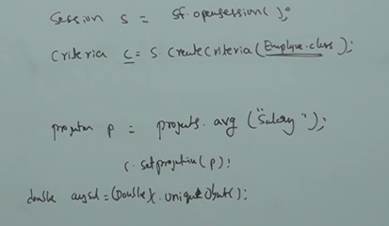
Criteria with Projection

Slide 19
CRUD OPERATION
Insert we use three method(save(),persist(),saveOrUpdate())
Session s=sf.openSession();
Transaction t=s.beginTransaction();
Student st=new Student();
st.setId("103");
st.setName("abd");
st.setEmail("abc@ymail.com");
st.setAddress("Dhaka");
String pk=(String)s.save(st);//it will return primary key
//s.persist()// it will return void
//s.saveOrUpdate()//it will return void
Difference of persist and saveorupdate() method: saveOrUpdate() method first fire select command with database and check in session if same id in session contain different data then it will update and if all data is same in session and command then it will not throw constraint violation exception. But in case of save() session and command contain same data then it will throw constraint violation exception

Slide 20
CRUD OPERATION
Update we used two method(update(),merge())
Session s=sf.openSession();
Transaction t=s.beginTransaction();
//s.get(Student.class,"101");
Student st=new Student();
st.setId("101");
st.setName("Irfan");
st.setEmail("abc@gmail.com");
st.setAddress("PSTU");
//s.update(st);
//s.merge(st);
Note:
update and merge() method update only non primary key data

Slide 21
CRUD OPERATION
Limitation of Update() method:
1 .if we want to update only one column data then update will insert Null in remaining column . Means here must we need to update complete record.
2.If session contain the same data which is present in database then it will throw duplicate data exception.
Difference between of Update() and merge() method:
In case of update() If session contain the same data which is present in database then it will throw duplicate data exception. But In case of merge() method if session is contain the same data which is present in database then it will not throw duplicate data exception
(Note: it is happen when we are performing get() as well as update() operation in same program )

Slide 22
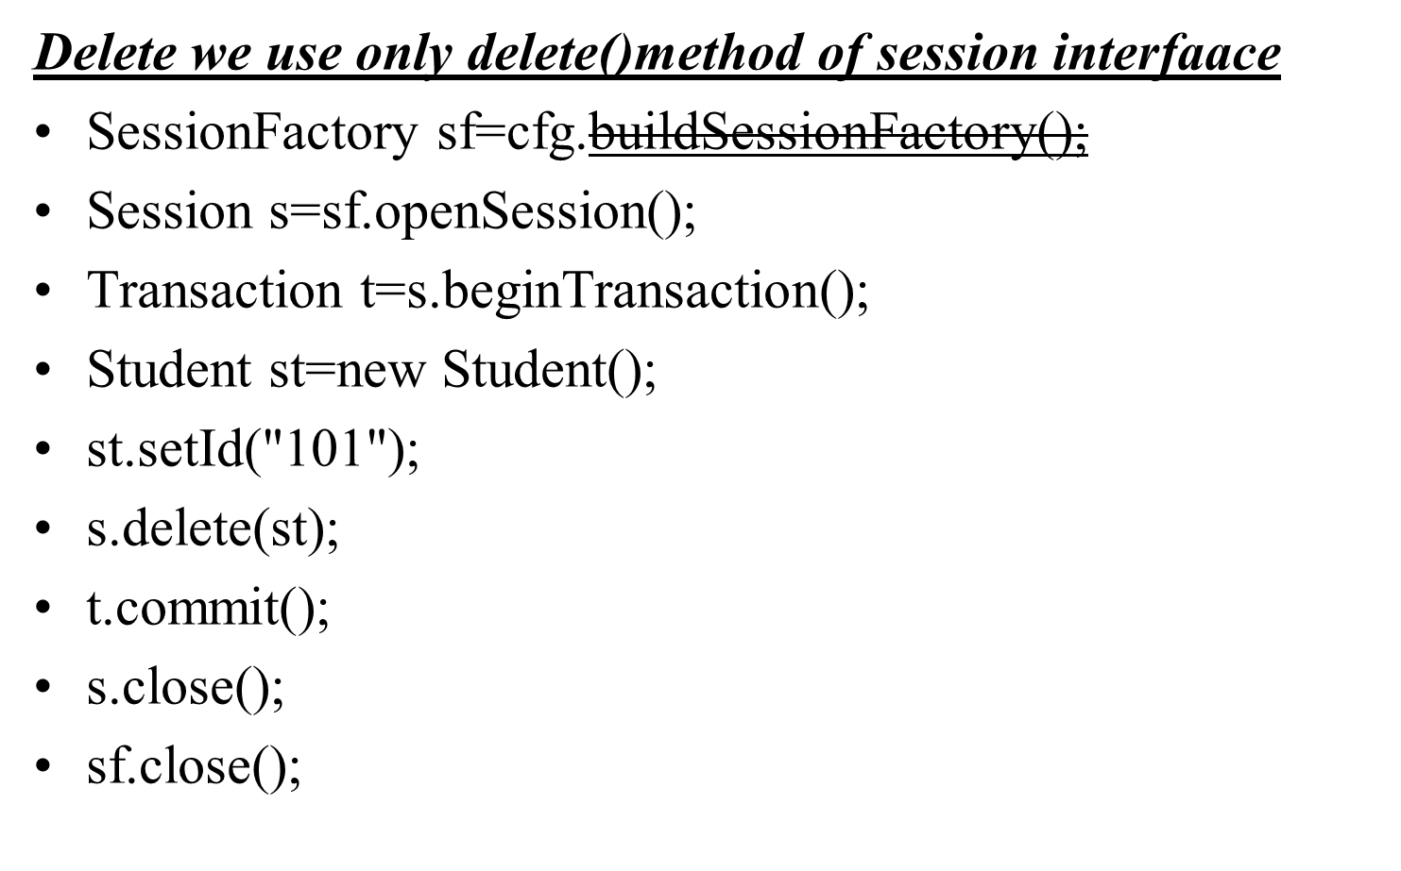
CRUD OPERATION

Slide 23
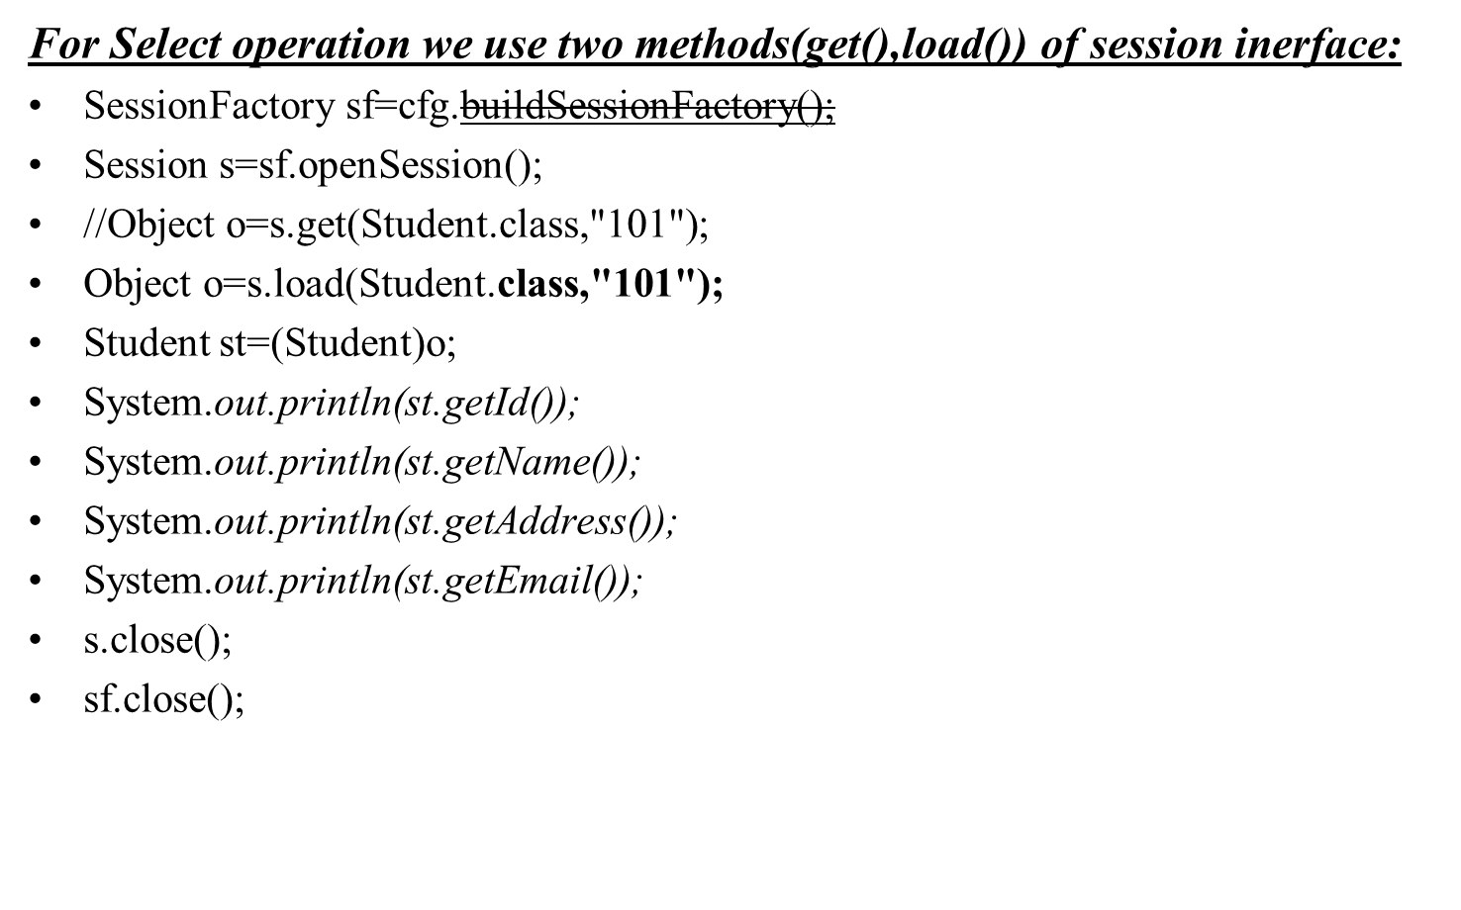
CRUD OPERATION

Slide 24
CRUD OPERATION
Difference between of get() and load() method:
1 .get() is called eager method because first it will fire select query then print all primary as well as non primary key data, while in case of load() it is called lazy method because first it will print primary key data then it will fire select query, after that print non primary key data(when it will reach non primary data then it will fire select query).
2.In case of get() if we fetch the data which is not present in database then it will throw NullPointerException while in case of load() if we fetch the data which is not present in data base then first it will display primary key data afterr that it will throw ObjectNotFoundException

Slide 25
HQL(Hibernate Query Language)
Using HQL we can perform 4 operatio
1.Insert
2.update
3.delete
4.select
Limitation of Insert : using HQL if we want to insert the data then we will store one table data to another table. means user data can not be insert in data base table.
Query Class methods.
1.executeUpdate() : This method used for DML Operation
2.uniqueObject()
3.list()

Slide 26
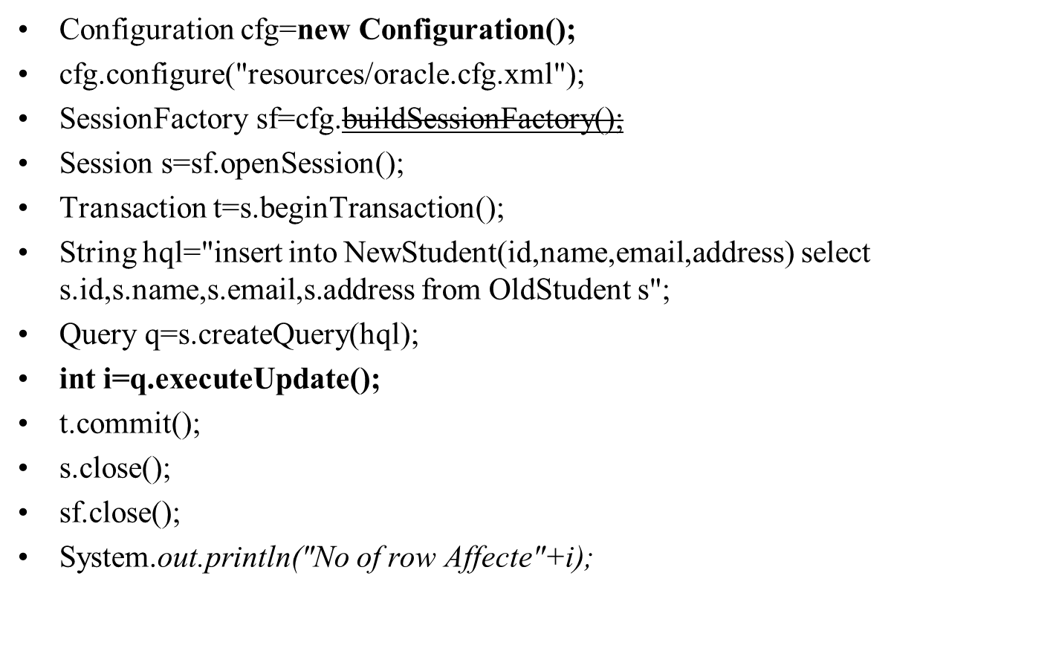
HQL(Insert)

Slide 27
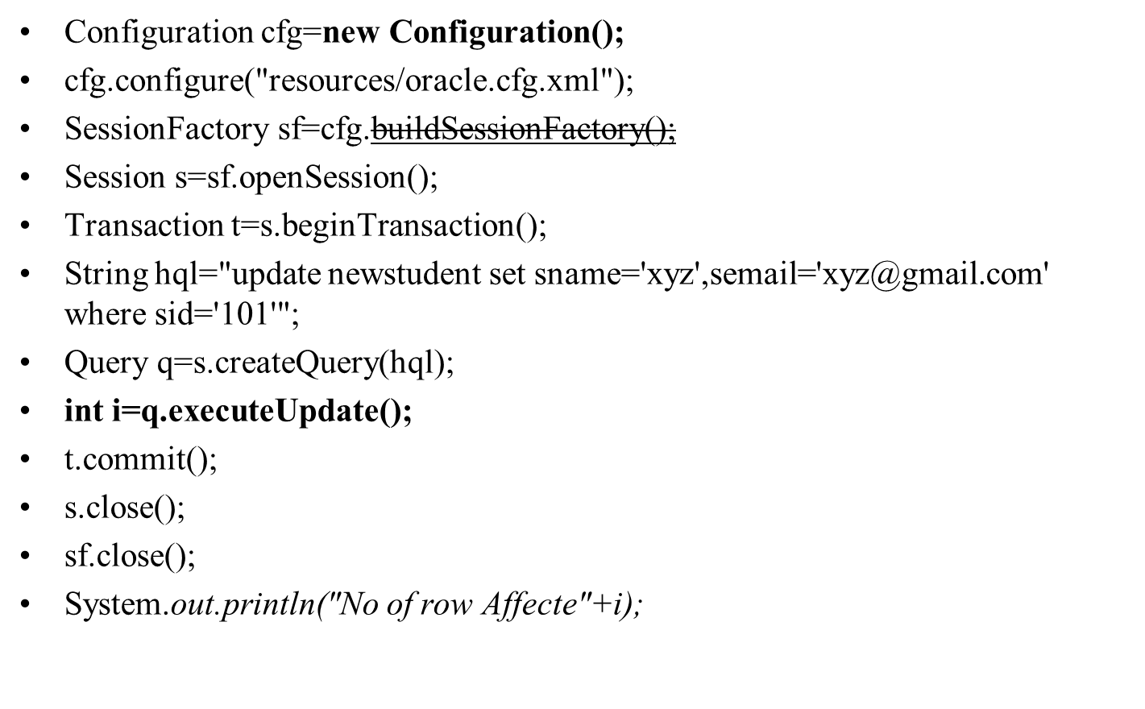
HQL(Update)

Slide 28
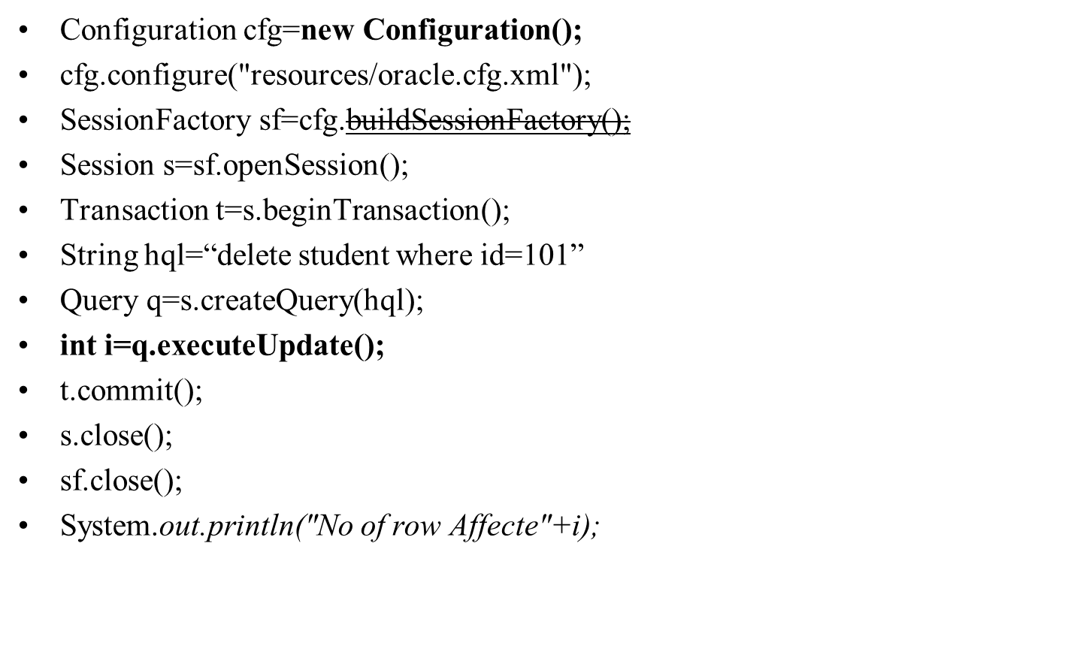
HQL(Delete)

Slide 29
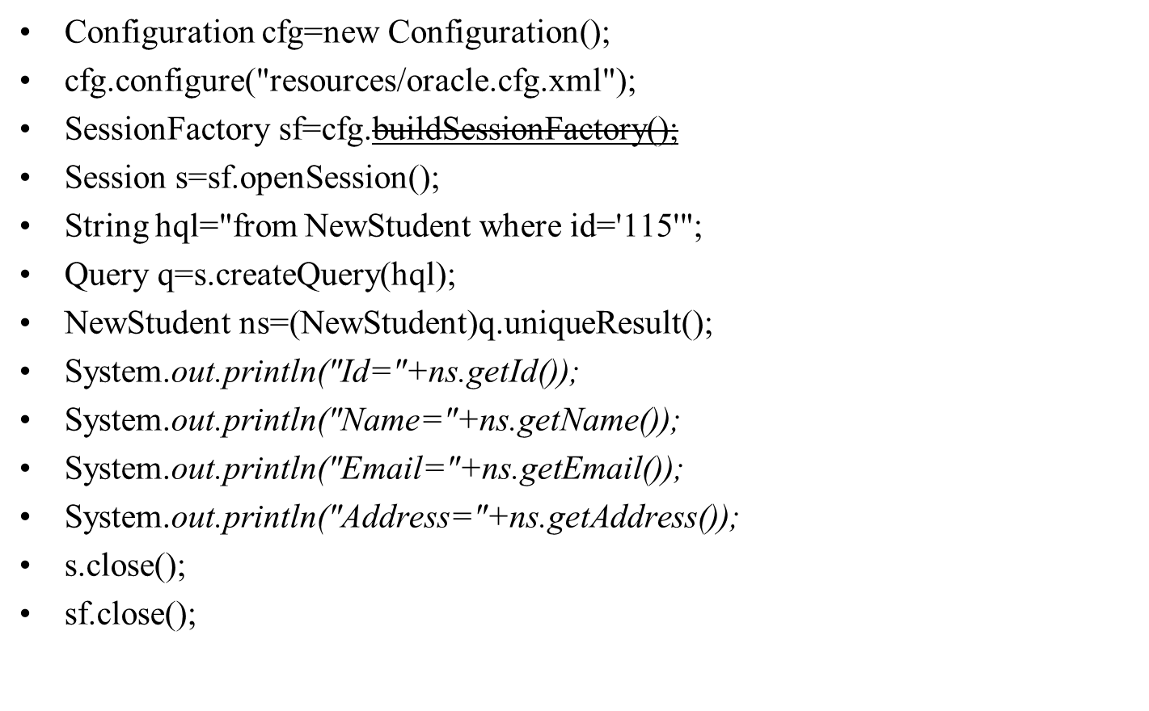
HQL(Select with one row data)

Slide 30
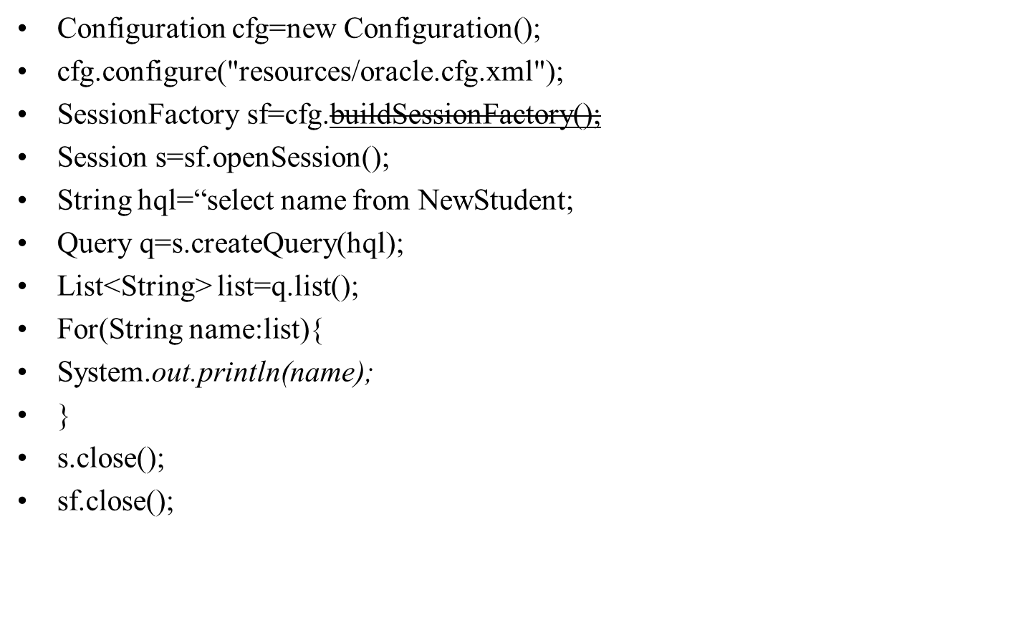
HQL(Select with one column data)

Slide 31
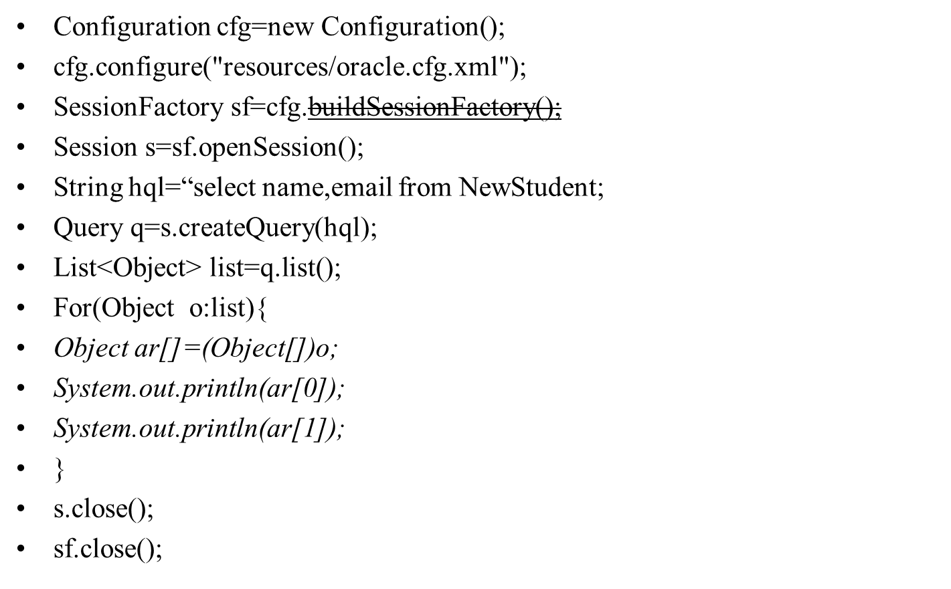
HQL(Select with multiple column data)

Slide 32
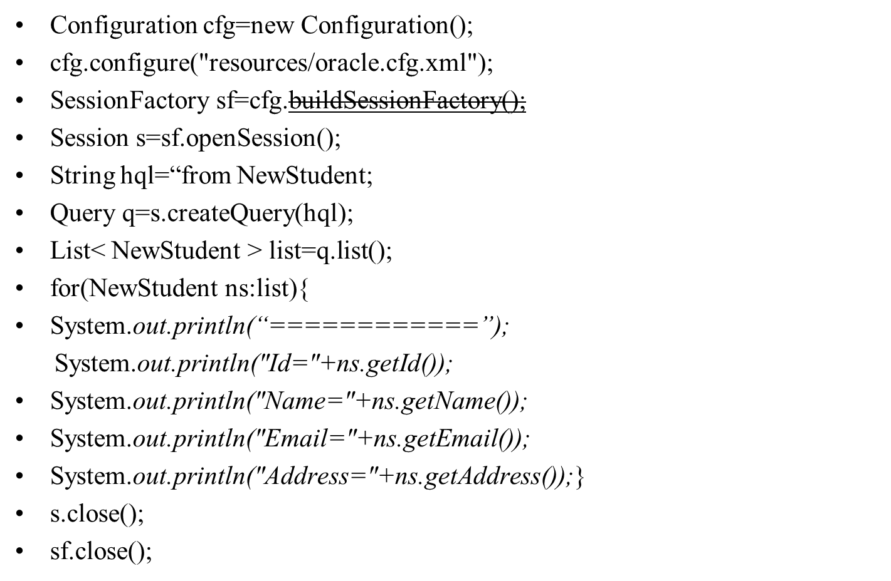
HQL(Select All)

Slide 33
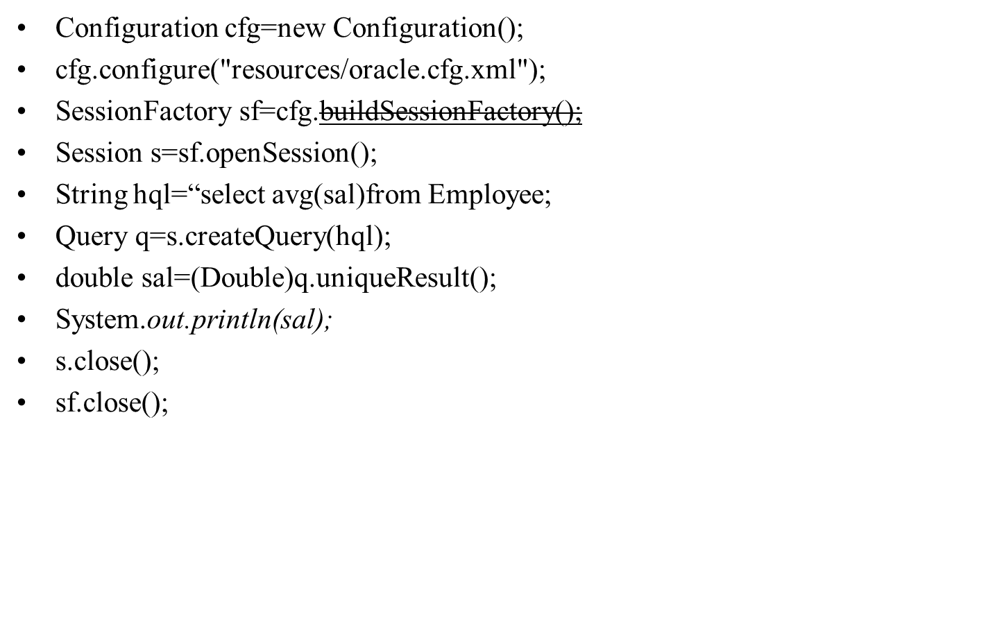
HQL(Select with aggregate function)

Slide 34
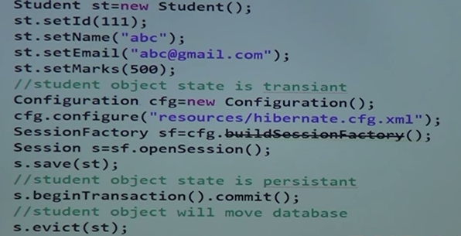

Hibernate Object State

Slide 35
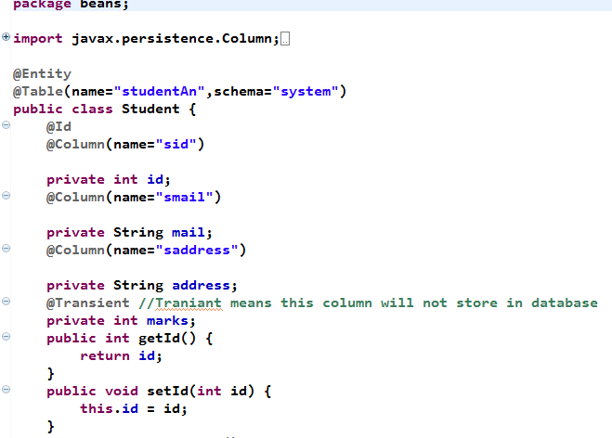
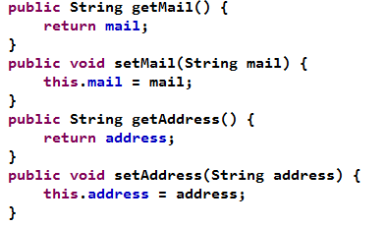
Hibernate Annotation

Slide 36
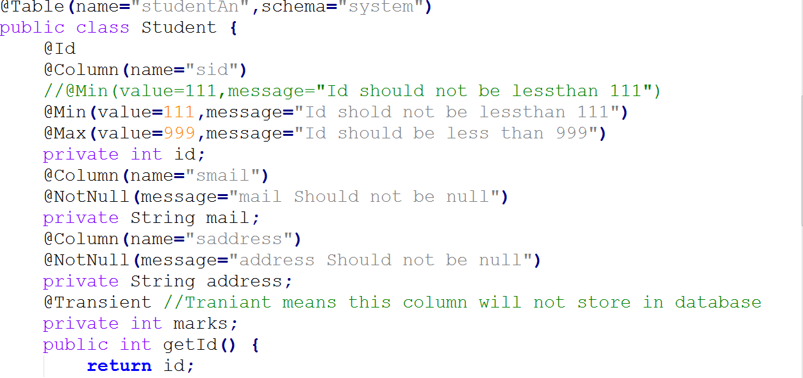
Hibernate Validation

Slide 37
Hibernate Is a Relation Ship
Three type of is a relationship in Hibernate
1.Table per Class
2.Table per sub class
3.Table per concrete class

Slide 38
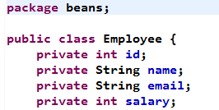



Table per class(POJO)

Slide 39
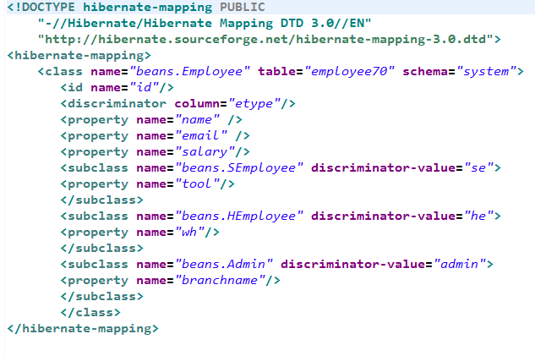
Table per class(mapping)

Slide 40
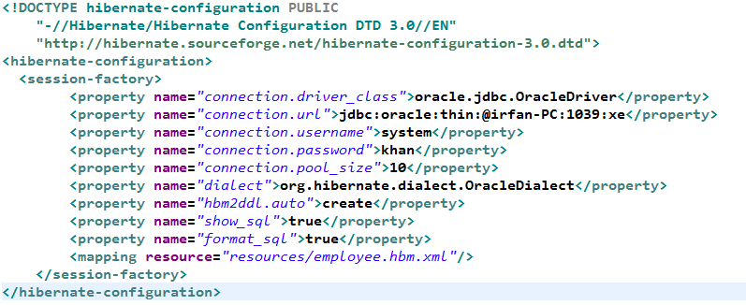
Table per class(CFG)

Slide 41
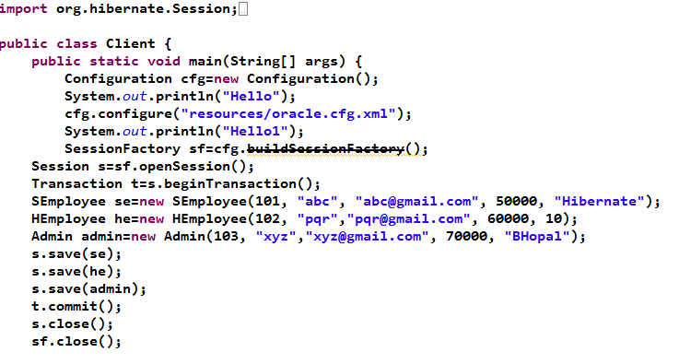
Table per class(Client)

Slide 42
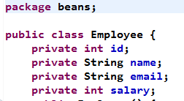



Table sub class(POJO)

Slide 43
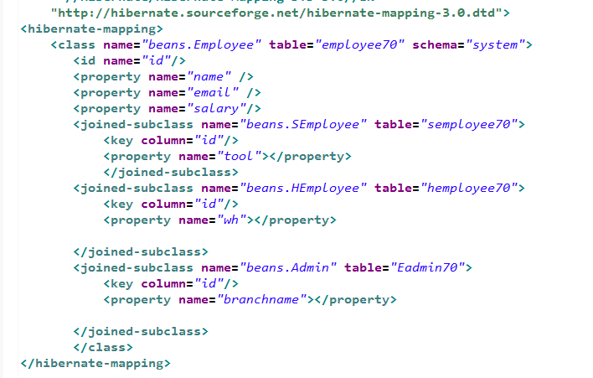
Table per sub class(mapping)

Slide 44
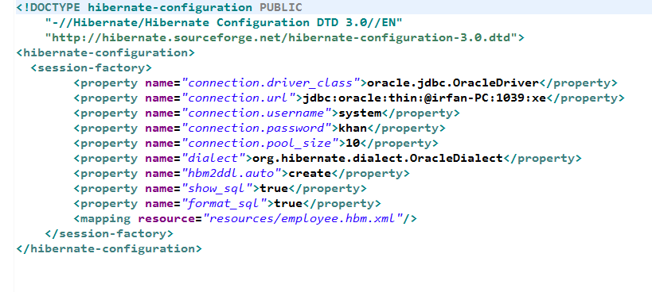
Table per sub class(CFG)

Slide 45
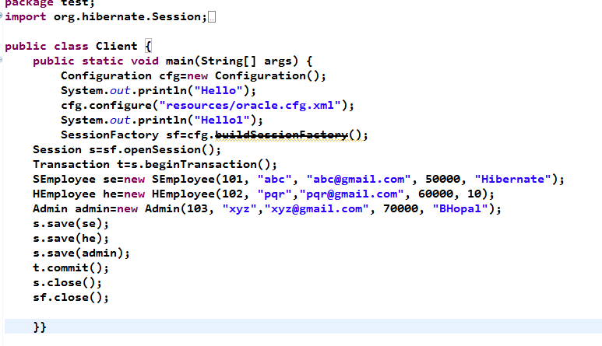
Table per sub class(Client)

